Slide 1

P peline
The Data
Machine Learning II: Regression, Decision Trees & Naïve Bayes
© Jennifer Mankoff
The Data Pipeline; HCII; Spring 2014
Slides modified & borrowed from Carolyn Rosé
Want to go deeper? http://see.stanford.edu/see/lecturelist.aspx?coll=348ca38a-3a6d-4052-937d-cb017338d7b1

Slide 3
Plan for today
Introduce some algorithms
Logistic Regression
Decision Trees
Naïve Bayes
Talk about math behind them; key assumptions
Logistics
Lots of old quizzes
Byte 5

Slide 4
How do you pick your features?
Too many can lead to overfitting [but feature selection can help with this]
Too few can fail to capture the information needed for prediction
http://selfiecity.net/selfiexploratory/

Slide 5
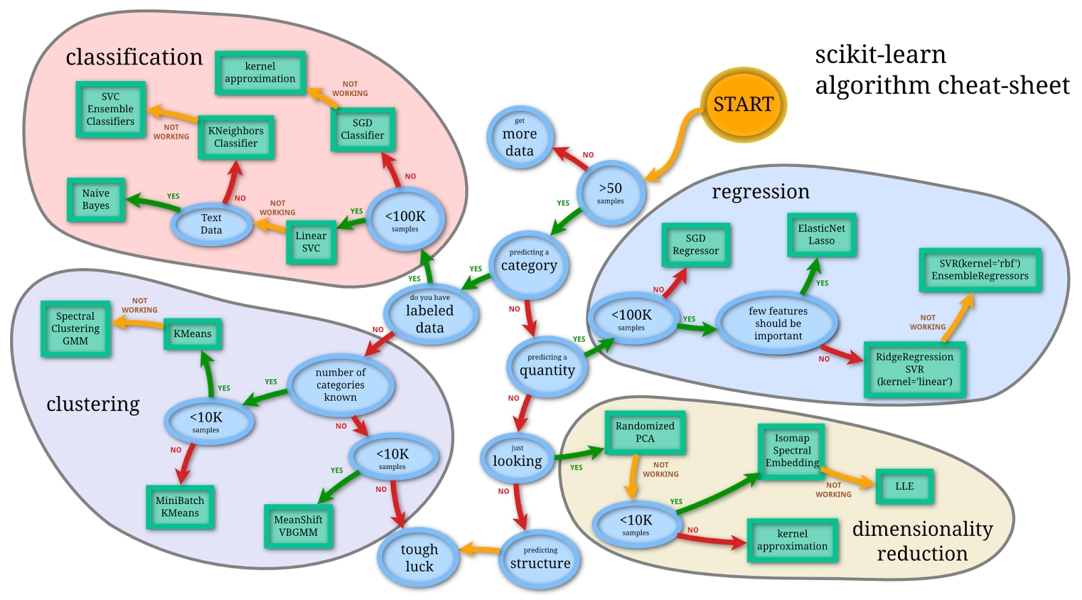
Selecting algorithms
http://www.quora.com/What-are-the-advantages-of-different-classification-algorithms

Slide 6
Selecting algorithms
http://www.quora.com/What-are-the-advantages-of-different-classification-algorithms

Slide 7
Regression: Predicting a Quantity
y
Observed y for x_{i}
Random Error for x_{i}
e_{i}
b₁
Predicted for x_{i}
b₀
x
x_{i}
x
The individual random error terms e_{i} have a mean of zero
Notes:
This works in two dimensions

Slide 8
Least Squares Regression
b₀ and b₁ must minimize
y
Observed Value of y for x_{i}
e_{i}
Estimated Slope = b₁
Predicted Value for x_{i}
Intercept = b₀
x
Notes:
Note we can replace y-cap with b0 – b1x

Slide 9
Learning in n dimensions
Given training examples:
x_{1..i} in R^{n} [our feature vectors]
And labels
y_{1..i} in R
we want to learn f(x) = w^{T}x + b

Slide 10
Animal Outcomes
Result is no longer continuous:
Will an animal be successfully placed (or euthanized?)
1 Placed
2 Euthanized

Slide 11
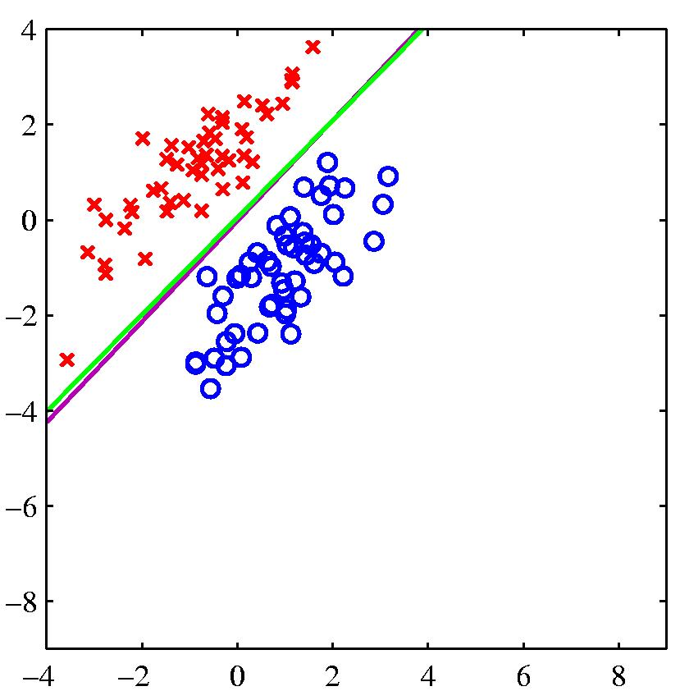
Estimated Logistic Regression Model
Given training examples:
x_{1..i} in R^{n} [our feature vectors]
And labels
y_{1..i} in R
we want to learn w^{T}x + b + e
(that’s just matrix speak for α + βX + e)
Notes:
This works in two dimensions

Slide 12
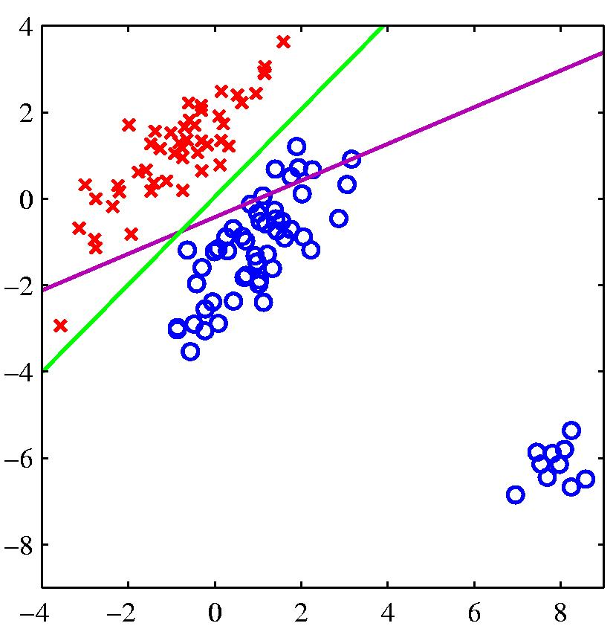
Problems with using least squares for classification
logistic regression
least squares regression
If the right answer is 1 and the model says 1.5, it loses, so it changes the boundary to avoid being “too correct”

Slide 13
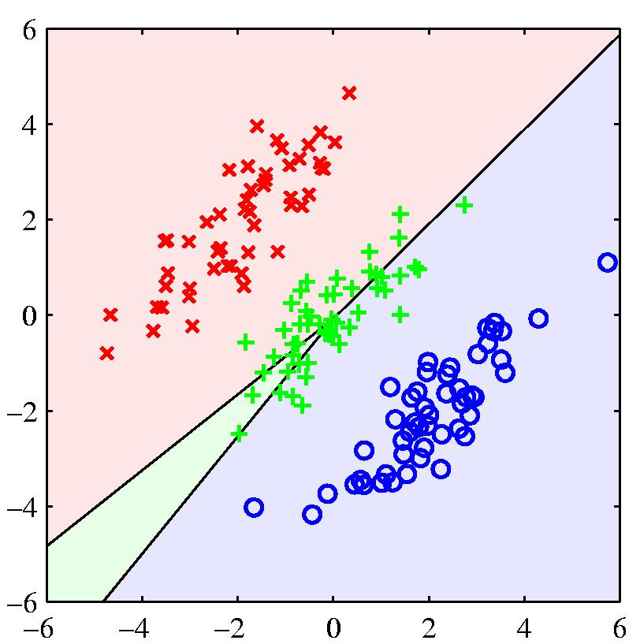
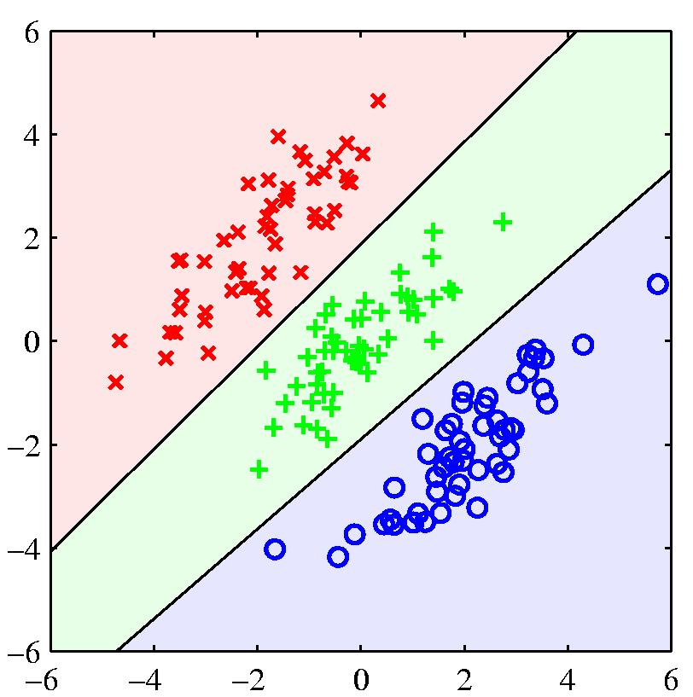
Another example where least squares regression gives poor decision surfaces

Slide 14
Goal of Logistic Regression
Key idea: instead of predicting a number in R, predict the probability of a class label.
p+ = P(class is positive|features) p- = P(class is negative|features)
Base p on the projection that gives the best separation of the classes.

Slide 15
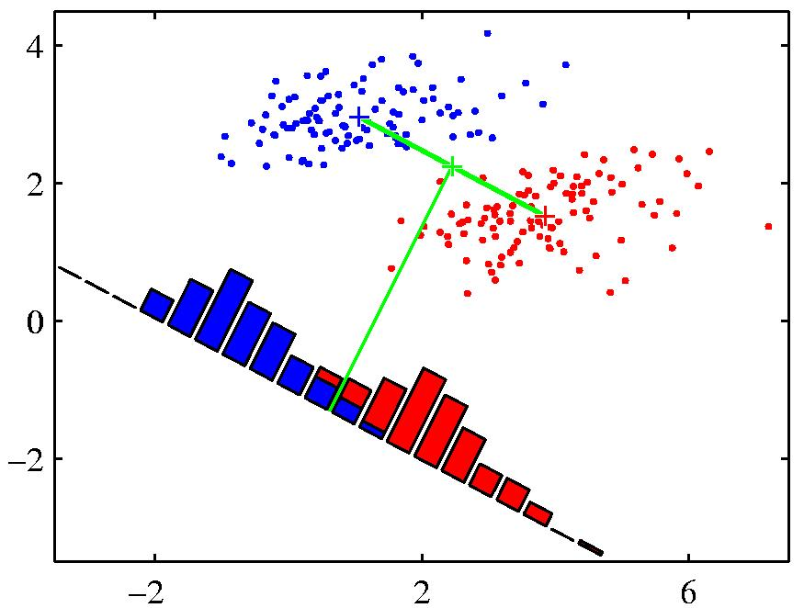
What do we mean by ‘best separation’?
When projected onto the line joining the class means, the classes are not well separated.
Slides from www.cs.toronto.edu/~hinton
Notes:
An obvious direction to choose is the direction of the line joining the class means. But if the main direction of variance in each class is not orthogonal to this line, this will not give good separation

Slide 16
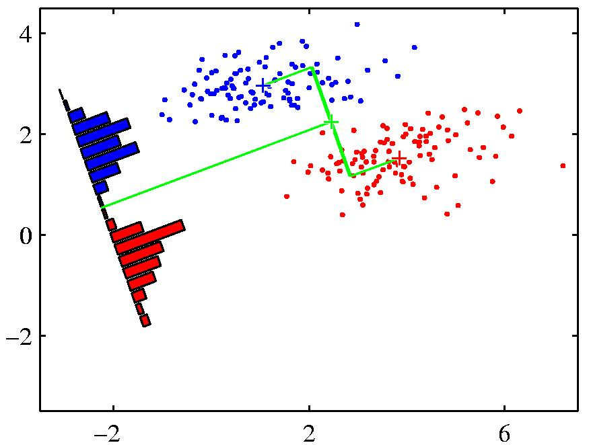
What do we mean by ‘best separation’?
When projected onto the line joining the class means, the classes are not well separated.
Fisher’s Discriminant: A better choice
Slides from www.cs.toronto.edu/~hinton
Notes:
An obvious direction to choose is the direction of the line joining the class means. But if the main direction of variance in each class is not orthogonal to this line, this will not give good separation

Slide 17
Modeling Logistic Regression
We want to decide a class
The "logit" model solves these problems: ln[p/(1-p)] = α + βX + e
p is the probability that the event Y occurs, p(Y=1)
p/(1-p) is the "odds ratio"
ln[p/(1-p)] is the log odds ratio, or "logit"
WhitHead: www.appstate.edu/~whiteheadjc/service/logit/logit.ppt

Slide 18
More:
The logistic distribution constrains the estimated probabilities to lie between 0 and 1.
The estimated probability is: Since ln[p/(1-p)] = α + βX + e
WhitHead: www.appstate.edu/~whiteheadjc/service/logit/logit.ppt

Slide 19
More:
The logistic distribution constrains the estimated probabilities to lie between 0 and 1.
The estimated probability is: Since ln[p/(1-p)] = α + βX + e p = 1/[1 + exp(-α - β X +e)]
WhitHead: www.appstate.edu/~whiteheadjc/service/logit/logit.ppt

Slide 20
More:
The logistic distribution constrains the estimated probabilities to lie between 0 and 1.
The estimated probability is: Since ln[p/(1-p)] = α + βX + e p = 1/[1 + exp(-α - β X +e)]
Called
if you let α + β X =0, then p = .50
as α + β X gets really big, p approaches 1
as α + β X gets really small, p approaches 0
WhitHead: www.appstate.edu/~whiteheadjc/service/logit/logit.ppt

Slide 21
Assigning a class
Definition:
Squeezes the real line into [0,1]
Differentiable: (nice exercise)

Slide 22
Soft threshold interpretation
If y> 0, σ(y) goes to 1 very quickly.
If y<0, σ(y) goes to 0 very quickly.
Notes:
Figure 18 from Russell and Norvig.

Slide 23
Probabilistic Interpretation
The sigmoid can be interpreted in terms of the class odds p+/(1-p+)
Exercise: Show the following implication for the class odds:
Therefore the log class odds.
Notes:
P(1+exp(-y)) = 1
P + pexp(-y) = 1
Pexp(-y) = 1-p
p(e^-y)(e^y) = 1-p (e^y)
p/(1-p) = e^y

Slide 24
Logistic regression
Since
we know
so we can estimate w by
minimizing training error
Notes:
P(1+exp(-y)) = 1
P + pexp(-y) = 1
Pexp(-y) = 1-p
p(e^-y)(e^y) = 1-p (e^y)
p/(1-p) = e^y

Slide 25
Minimizing the error (learning) is just search over the weight space
Searching for global minimum
Incrementally descend along gradient Δ(w)
Update weights using something like:
w_{j} = w_{i} + η Δ(w)
Manipulate step size (η) based on various factors
Typically proportional to E(w, b) -- gradient descent
We can define a convex cost function! (only one minimum)
Notes:
‘kick the duck’ (simulated annealing) ; damped over time – simulated annealing if you have a non-convex function
http://www.quora.com/Convex-Optimization/Why-is-Convex-Optimization-such-a-big-deal-in-Machine-Learning

Slide 26
Minimizing Error
we want to minimize an error term based on w
When E(w) is minimized we have our best fit
Notes:
P(1+exp(-y)) = 1
P + pexp(-y) = 1
Pexp(-y) = 1-p
p(e^-y)(e^y) = 1-p (e^y)
p/(1-p) = e^y

Slide 27
Minimizing Error
we want to minimize an error term based on w
When E(w) is minimized we have our best fit
a ‘loss’ function whose definition can vary (affects the details of what we learn)
Notes:
an upper bound on mis-classification error

Slide 28
Minimizing Error
The actual correct class (the label, based on our training data)
we want to minimize an error term based on w
When E(w) is minimized we have our best fit

Slide 29
Minimizing Error
we want to minimize an error term based on w
When E(w) is minimized we have our best fit
The predicted class (x.w)

Slide 30
Minimizing Error
we want to minimize an error term based on w
When E(w) is minimized we have our best fit
a ‘regularization term’ which penalizes model complexity

Slide 31
Minimizing Error
we want to minimize an error term based on w
When E(w) is minimized we have our best fit
A parameter which affects R’s impact on the search

Slide 32
Gradient Descent: Linear vs Logistic
Linear regression: y= α + β₁*X + β₂ *W + β₃ *Z… = ϴ^{T}x
Logistic regression:
Algorithm the same (just solving for diff)
Repeat until the difference in error is small:
At each step change w based on the error and the step size η
w_{j} = w_{i} - η Δ(w)

Slide 33
Gradient Descent: Linear vs Logistic
Linear regression: y= α + β₁*X + β₂ *W + β₃ *Z… = ϴ^{T}x
Logistic regression:
Algorithm the same (just solving for diff)
Repeat until the difference in error is small:
Notes:
Based on a common loss function
Theta is just a matrix representation of the weights

Slide 34
Selecting algorithms
http://www.quora.com/What-are-the-advantages-of-different-classification-algorithms

Slide 35
Selecting algorithms
http://www.quora.com/What-are-the-advantages-of-different-classification-algorithms

Slide 36
Classification (Learning) Algorithms
Two of the simplest alg. tend to give very good results on discrete (non-sequence) classification
Efficient training and classification time
Comparatively simple and easy to use (not a lot of parameters to set, etc.)
Naïve Bayes
Decision Trees

Slide 37
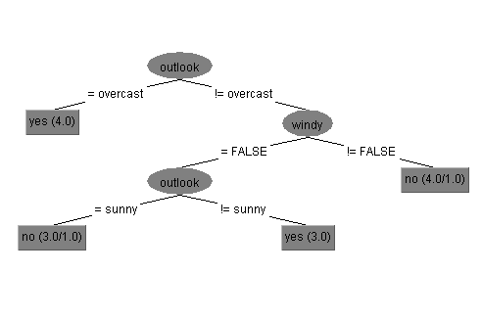
How Decision Trees Work
Notes:
Uses simple nested conditional structure
Tree structured
At each interior node we look at one feature
Value of this feature selects a sub-tree for making the rest of the decision (so edges are labeled with feature values)
At leaves we make a classification (assign the class)

Slide 38
How Decision Trees Work
Each interior node looks at one feature
Notes:
Uses simple nested conditional structure
Tree structured
At each interior node we look at one feature
Value of this feature selects a sub-tree for making the rest of the decision (so edges are labeled with feature values)
At leaves we make a classification (assign the class)

Slide 39
How Decision Trees Work
Feature value selects which subtree to traverse
Notes:
Uses simple nested conditional structure
Tree structured
At each interior node we look at one feature
Value of this feature selects a sub-tree for making the rest of the decision (so edges are labeled with feature values)
At leaves we make a classification (assign the class)

Slide 40
How Decision Trees Work
Leaves specify the classification
Notes:
Uses simple nested conditional structure
Tree structured
At each interior node we look at one feature
Value of this feature selects a sub-tree for making the rest of the decision (so edges are labeled with feature values)
At leaves we make a classification (assign the class)

Slide 41
Easy to train recursively
BuildTree(trainingSet)
// base case … (more base cases later)
If trainingSet only has one label on all instances
Return new Leaf(trainingSet.label)
// recursive case
Pick a feature Fn we haven’t split with before // … how?
result = new SplitNode(Fn)
For each value unique value f_{i} of feature Fn
trainSubset= subset of trainingSet with Fn= f_{i}
result.addChild(BuildTree(trainSubset))
Return result
(Note: “standard” algorithm is C4.5 [Quinlan 93])

Slide 42
Decision Trees
How do we pick features to base splits on?
Some features might be mostly noise (not very predictive of label)
splitting with doesn’t narrow down your decision much
Other features might have high information content
Notes:
Intuitively would like the features with the most information in them
Turns out there is a nice information theoretic way to estimate this: “Information Gain”
… will need a short trip into information theory

Slide 43
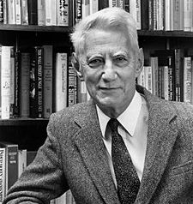
Information Entropy
(AKA Shannon Entropy):
a measure of uncertainty
Less uncertainty (less entropy) → more predictable → less information
Provides a lower bound on the average number of bits needed to encode / transmit something
Intuitively: proportional to how much information is in the thing to be transmitted
Claude Shannon (1916-2001) The father of information theory

Slide 44
Information Entropy
Assume a discrete random variable X w/ values {x₁,x₂…,x_{n}}
Uncertainty u_{i} associated with x_{i} (the number of bits needed to designate x_{i} in a message) defined as :
If X was uniformly distributed [P(x_{i}) = 1/n]:
u_{i} = log₂ n
For arbitrary non-uniform distribution:
u_{i} = log₂(1/P(x_{i})) = - log₂P(x_{i})
Entropy gives the average number of bits to encode a message of symbols drawn from X
Entropy(X) = H(X) = P(x₁) u₁+ P(x₂) u₂ +…+ P(x_{n}) u_{n}
= - ∑_{i=1..n} P(x_{i}) log₂ P(x_{i})

Slide 45
Information Entropy
Assume a discrete random variable X w/ values {x₁,x₂…,x_{n}}
Uncertainty u_{i} associated with x_{i} (the number of bits needed to designate x_{i} in a message) defined as :
If X was uniformly distributed [P(x_{i}) = 1/n]:
u_{i} = log₂ n
For arbitrary non-uniform distribution:
u_{i} = log₂(1/P(x_{i})) = - log₂P(x_{i})
Entropy gives the average number of bits to encode a message of symbols drawn from X
Entropy(X) = H(X) = P(x₁) u₁+ P(x₂) u₂ +…+ P(x_{n}) u_{n}
= - ∑_{i=1..n} P(x_{i}) log₂ P(x_{i})

Slide 46
Information Entropy
Assume a discrete random variable X w/ values {x₁,x₂…,x_{n}}
Uncertainty u_{i} associated with x_{i} (the number of bits needed to designate x_{i} in a message) defined as :
If X was uniformly distributed [P(x_{i}) = 1/n]:
u_{i} = log₂ n
For arbitrary non-uniform distribution:
u_{i} = log₂(1/P(x_{i})) = - log₂P(x_{i})
Entropy gives the average number of bits to encode a message of symbols drawn from X
Entropy(X) = H(X) = P(x₁) u₁+ P(x₂) u₂ +…+ P(x_{n}) u_{n}
= - ∑_{i=1..n} P(x_{i}) log₂ P(x_{i})

Slide 47
Information Entropy
Assume a discrete random variable X w/ values {x₁,x₂…,x_{n}}
Uncertainty u_{i} associated with x_{i} (the number of bits needed to designate x_{i} in a message) defined as :
If X was uniformly distributed [P(x_{i}) = 1/n]:
u_{i} = log₂ n
For arbitrary non-uniform distribution:
u_{i} = log₂(1/P(x_{i})) = - log₂P(x_{i})
Entropy gives the average number of bits to encode a message of symbols drawn from X
Entropy(X) = H(X) = P(x₁) u₁+ P(x₂) u₂ +…+ P(x_{n}) u_{n}
= - ∑_{i=1..n} P(x_{i}) log₂ P(x_{i})

Slide 48
Conditional Entropy
Specific Conditional Entropy
Entropy(F_{a} | F_{b} = x_{i})
Entropy of feature F_{a} among instances in which feature F_{b} = x_{i}
Conditional Entropy across the full training set
Entropy(Y | X): average specific conditional entropy of Y
Entropy in Y if X is known
Also expected number of bits to transmit Y if both sides already know the value of X
Entropy(Y | X) = ∑_{i=1..n} P(X= x_{i}) Entropy(Y | X = x_{i})

Slide 49
Information Gain (AKA Mutual Information or Kullback-Leibler divergence)
IG(Y | X) = Entropy(Y) – Entropy(Y | X) also given as IG(Y, X) and I(Y;X)
Reduction in entropy of Y (uncertainty about Y) by knowing X
If I need to transmit Y, how many bits on average would it save me if both sides already knew X
If I am predicting Y how much information does X provide
Case we are interested in: IG(Label | Feature)
Higher IG for a feature indicates more information about the label is in that feature
– Very useful for feature selection!

Slide 50
Impact on Decision Trees…
BuildTree(trainingSet)
// base case … (more base cases later)
If trainingSet only has one label on all instances
Return new Leaf(trainingSet.label)
// recursive case
Pick a feature Fn we haven’t split with before // … how?
result = new SplitNode(Fn)
For each value unique value f_{i} of feature Fn
trainSubset= subset of trainingSet with Fn= f_{i}
result.addChild(BuildTree(trainSubset))
Return result
(Note: “standard” algorithm is C4.5 [Quinlan 93])

Slide 51
Impact on Decision Trees…
BuildTree(trainingSet)
// base case … (more base cases later)
If trainingSet only has one label on all instances
Return new Leaf(trainingSet.label)
// recursive case
Pick a feature Fn we haven’t split with before // … how?
result = new SplitNode(Fn)
For each value unique value f_{i} of feature Fn
trainSubset= subset of trainingSet with Fn= f_{i}
result.addChild(BuildTree(trainSubset))
Return result
Split with feature having the largest IG
(Note: “standard” algorithm is C4.5 [Quinlan 93])

Slide 52
Impact on Decision Trees…
BuildTree(trainingSet)
// base case … (more base cases later)
If trainingSet only has one label on all instances
Return new Leaf(trainingSet.label)
// recursive case
Pick a feature Fn we haven’t split with before // … how?
result = new SplitNode(Fn)
For each value unique value f_{i} of feature Fn
trainSubset= subset of trainingSet with Fn= f_{i}
result.addChild(BuildTree(trainSubset))
Return result
Split with feature having the largest IG
… Stop when gain is small to avoid overfitting
(Note: “standard” algorithm is C4.5 [Quinlan 93])
Notes:
(Note: “standard” algorithm is C4.5 [Quinlan 93])

Slide 53
Decision Trees – Overfitting
Algorithm will subdivide all the way down to single training instances to exactly “fit” training data
But doing well on training data doesn’t guarantee doing well on new data
Small numbers of training instances don’t generalize well (“noisy”)
Decision trees are particularly prone to overfitting
“Pruning” can help (typically done after tree construction)

Slide 54
Minimum description length principle
The simplest model that fits your data will generalize better
Complex models are more likely to over-fit
Decision trees can become complex when you try to optimize performance on training data
Sometimes 0R/1R are best!
The best algorithm for your data will give you exactly the power you need

Slide 55
Prepruning versus Postpruning
Prepruning: knowing when to stop growing a tree
Hard to do because sometimes the value of a feature doesn’t become clear until lower down on the tree
Interactions between features
You always have to have a stopping criterion, so in some sense you are doing prepruning
But in practice you over-shoot and then do post-pruning

Slide 56
Prepruning versus Postpruning
Postpruning: simplifying a tree after it is built
Easier because hindsight is 20/20
Less efficient because you might have done a lot of work that you’re going to throw away now

Slide 57
Reduced Error Pruning
Estimate the error rate at each node of both the original and resulting tree (after pruning)
Prune when keeping the subtree means the error goes up on an optimization set
Won’t work to use the training set to compute the error rate because the original tree was optimized over this set already
You can hold back some of the training data for an optimization set to use for pruning

Slide 58
Using Confidence Factors to Estimate Error
Confidence factor = .25
Means you are 75% sure the error rate is within the interval.
(
)
Estimate error based on training data
If it is within the interval, prune
Notes:
Similar principle to computing confidence
Lowering the confidence value causes more pruning
We use the estimate “pessimistically” by using the upper confidence limit on the error estimate

Slide 59
Using Confidence Factors to Estimate Error
Confidence factor = .25
Means you are 75% sure the error rate is within the interval.
(
)
Estimate error based on training data
If it is within the interval, prune
Notes:
We use the estimate “pessimistically” by using the upper confidence limit on the error estimate

Slide 60
Lowering confidence causes more pruning
Confidence factor = .25
Means you are 75% sure the error rate is within the interval.
(
)
Confidence factor = .10
Means you are 90% sure the error rate is within the interval.
(
)
Lowering the confidence value causes more pruning
Notes:
Similar principle to computing confidence
Lowering the confidence value causes more pruning
We use the estimate “pessimistically” by using the upper confidence limit on the error estimate

Slide 61
Thinking about the Confidence Factor
More error expected: We’ve only used one feature to at this point
[10A, 10B]
[5A,1B]
[5A,10B]
Less error expected: We have used more information to make a decision
[5A,2B]
[0A,7B]
(
)
Confidence factor = .10: You are 90% sure the error rate is within the interval.

Slide 62
Thinking about the Confidence Factor
More error expected: We’ve only used one feature to at this point
[10A, 10B]
[5A,1B]
For the difference in errors, is |t| < |t| ?
[5A,10B]
Less error expected: We have used more information to make a decision
[5A,2B]
[0A,7B]
(
)
Confidence factor = .10: You are 90% sure the error rate is within the interval.
Notes:
If the difference is big enough then we feel it is worth the risk of additional complexity/overfitting
Otherwise we cannot conclude that the difference in accuracy is real

Slide 63
Decision Trees Pros and Cons
Open world assumption
Only examine some attributes
Beyond that can use the majority class to decide
Divide and conquer approach
Global maximization of performance at each iteration
Prone to overfitting. Pruning important for maximizing performance

Slide 64
Closed World Assumption
Presumes all true statements are known
Observer can thus make inferences about new things: if they are not known, they are false

Slide 65
Open World Assumption
No single observer has complete information
Observer can only make inferences about things that derive from things it already know to be true
represent information as we discover it and cannot guarantee that we know everything true
statements depending on unknown features are unknown rather than false

Slide 66
Example:
Statement: Jane is on the plane
Question: Is Paul on the plane?

Slide 67
Example:
Statement: Jane is on the plane
Question: Is Paul on the plane?
OWA: Unknown
CWA: No!

Slide 68
Example: Decision Trees
Contain statements about how features relate to outcomes
Question: What happens when an attribute is included that is not in the tree?
Notes:
Answer: Use the attributes you have and then use the majority class to decide …

Slide 69
Selecting algorithms
http://www.quora.com/What-are-the-advantages-of-different-classification-algorithms

Slide 70
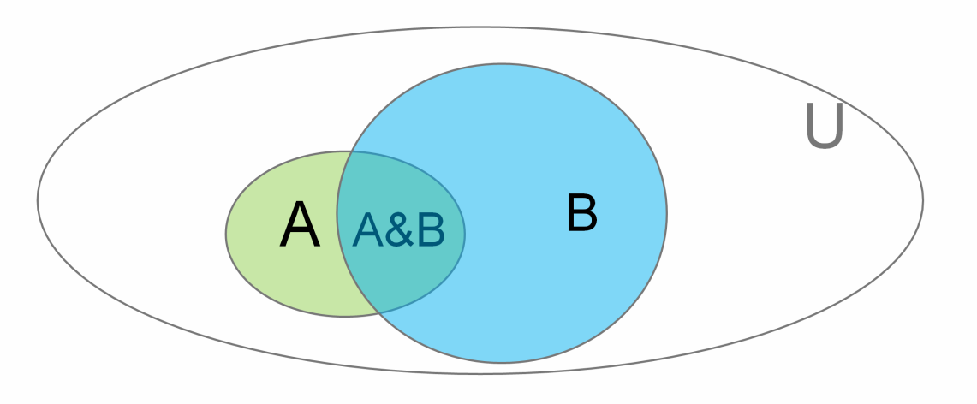
An Alternative: The Elegance of Statistics
We write P(A | B) to denote
“Probability of A given B” (or “… assuming B”)
or
“If we know B is true, what’s the probability of A”

Slide 71
Conditional Probability Example
Consider Jen’s Mobile data:
Location: {Shadyside, NSH, Hidden Valley, Other}
Activity: {Biking, Vehicle, Walking, Still, Other}
Conditional probabilities are useful in classification:
P(Walking| Location=Shadyside)
P(Sleeping | Location=NSH), etc
We can estimate these based on body of prior observations (e.g., count how many times walking when location was Shadyside)

Slide 72
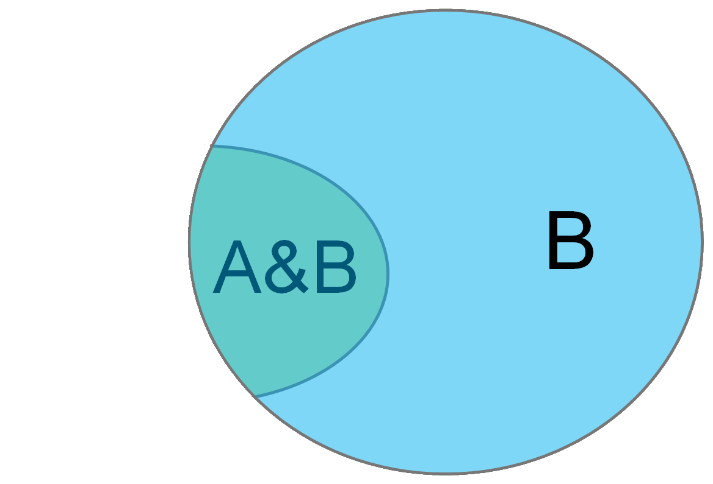
Conditional Probability
P(A | B) - “Probability of A given B”
You can think of this as just a change of universe
Probability of A treating B as the universe
→

Slide 73
Conditional Probability
P(A| B)
= |A&B|
|B|

Slide 74
Conditional Probability
P(A| B)
= |A&B|
|B|
Divide top and bottom by |U| …
|A&B|
= |U| = P(A&B)
|B| P(B)
|U|

Slide 75
Conditional Probability
P(Sleeping | NSH)
= P(Sleeping&NSH)
P(NSH)

Slide 76
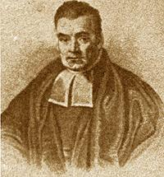
Naïve Bayes
Based on Bayes law
http://en.wikipedia.org/wiki/Bayes'_theorem
http://yudkowsky.net/rational/bayes
http://oscarbonilla.com/2009/05/visualizing-bayes-theorem/
Bayes Law (AKA Bayes theorem):
Rev. Thomas Bayes 1702-1761
P(B | A) P(A)
P(A | B) =
P(B)

Slide 77
Why is that true?

Slide 78
Why is that true?
P(A | B) = P(A&B)
P(B)

Slide 79
Why is that true?
P(A | B) = P(A&B)
P(B) → P(A | B)P(B)= P(A&B)

Slide 80
Why is that true?
P(A | B) = P(A&B)
P(B) → P(A | B)P(B)= P(A&B)
Now the converse
P(B | A) = P(A&B)
P(A) → P(B | A)P(A)= P(A&B)

Slide 81
Why is that true?
P(A | B) = P(A&B)
P(B) → P(A | B)P(B)= P(A&B)
Now the converse
P(B | A) = P(A&B)
P(A) → P(B | A)P(A)= P(A&B)
P(A | B)P(B) = P(B | A)P(A)

Slide 82
Why is that true?
P(A | B) = P(A&B)
P(B) → P(A | B)P(B)= P(A&B)
Now the converse
P(B | A) = P(A&B)
P(A) → P(B | A)P(A)= P(A&B)
P(A | B)P(B) = P(B | A)P(A) divide by P(B)

Slide 83
Why is that true?
P(A | B) = P(A&B)
P(B) → P(A | B)P(B)= P(A&B)
Now the converse
P(B | A) = P(A&B)
P(A) → P(B | A)P(A)= P(A&B)
P(A | B)P(B) = P(B | A)P(A) divide by P(B)
P(B | A) P(A)
P(A | B) =
P(B)

Slide 84
Bayes Law
Bayes Law (AKA Bayes theorem):
Rev. Thomas Bayes 1702-1761
P(B | A) P(A)
P(A | B) =
P(B)

Slide 85
Bayes Law
Bayes Law (AKA Bayes theorem):
Rev. Thomas Bayes 1702-1761
P(NSH | Sleeping) P(Sleeping)
P(Sleeping | NSH) =
P(NSH)

Slide 86
Bayes Law
Bayes Law (AKA Bayes theorem):
Rev. Thomas Bayes 1702-1761
P(NSH | Sleeping) P(Sleeping)
P(Sleeping | NSH) =
P(NSH)

Slide 87
Naïve Bayes
Would like to know the probability that the true class is C_{i} given the occurrence of observed feature vector F = <f₁, f₂, …, f_{n} >
Compute as:
P(F | C_{i}) P(C_{i})
Likelihood * Prior
P(C_{i} | F) =
=
P(F)
Evidence

Slide 88
Naïve Bayes
Would like to know the probability that the true class is C_{i} given the occurrence of observed feature vector F = <f₁, f₂, …, f_{n} >
Compute as:
Class C_{x} with the highest computed probability is used as the classification result
P(F | C_{i}) P(C_{i})
Likelihood * Prior
P(C_{i} | F) =
=
P(F)
Evidence

Slide 89
Small Issues
What happens when C_{i} never occurs in the training data?
P(C_{i}) = 0, therefore C_{i} never wins & is never selected!
(Can insist P(C_{i}) =1 to avoid this, but in general rare events can be hard to handle well)
We have implicitly assumed F_{k} comes from a discrete set e.g., so we can simply count the occurrences to compute P(F_{k} | C_{i})
Notes:
There are good ways to quantize (pick good “bins”) for e.g., numeric features automatically, but we won’t cover this
----- Meeting Notes (3/5/15 09:54) -----
should be Ci = 1 not P(Ci) = 1.

Slide 90
Naïve Bayes Pros and Cons
Elegant balance of features and prior probabilities
But depends on assumptions that are not in general true
Will tend to fail when things are highly conditional
i.e., System behaves very differently when X is true vs. Y is true
Works less well when attributes are redundant or classes are skewed (priors win)
Robust when features are missing (because of prior probabilities) (but not during training)
Notes:
In practice statistical approach doesn’t work better than “ad-hoc” methods
Closed world assumption: can make assumptions about things being ‘false’ [if not known]

Slide 91
Selecting algorithms
http://www.quora.com/What-are-the-advantages-of-different-classification-algorithms

Slide 92
Naïve Bayes vs Decision Trees
Decision Trees use contingencies between patterns of attribute values as a basis for decision making
Naïve Bayes treats attributes as independent pieces of evidence that the decision should go one way or another
Most of the time in real data sets the values of the different attributes are not independent of each other

Slide 93
Review: Decision Trees & Naïve Bayes
Minimum description length principal
Decision trees are simple and easily learned
Add nodes based on information gain
Naïve Bayes pros
Takes priors into account
Robust even when features are missing
Naïve Bayes cons
Assumptions: Independence; Closed world
Fails when things are highly conditional
Fails when data is highly skewed

Slide 94
Need to add slides on regression and maybe unsupervised learning/clustering

Slide 95
Example: Stepgreen data

Slide 96
Actions that don’t change
Rank | Already Do | Unappealing
1 | Turn out lights when leaving home (16%) | Install motion sensors for some lights (5%)
2 | Use a manual toothbrush (12%) | Turn off and unplug devices at work (5%)
3 | Turn out lights when leaving a room (12%) | Volunteer time (5%)
Notes:
These actions don’t change, meaning that many users either already did them or didn’t plan on committing them
Already Do: Top 3 actions already done based on %age of users who marked them in each category in our open deployment.
Unappealing: examples of actions few committed to/already do.

Slide 97
Popular, High Impact New Actions
Name | Impact
Set your home computer to sleep | 617 lbs CO₂/yr
Recycle aluminum | 116 lbs CO₂/yr
Adjust your water heater thermostat to 120F | 1242 lbs CO₂/yr
Notes:
These actions represent change – new things that people committed to
These are examples taken from the top 10 new actions. On average, users commited to about 8 new actions after reporting what they already do.

Slide 98
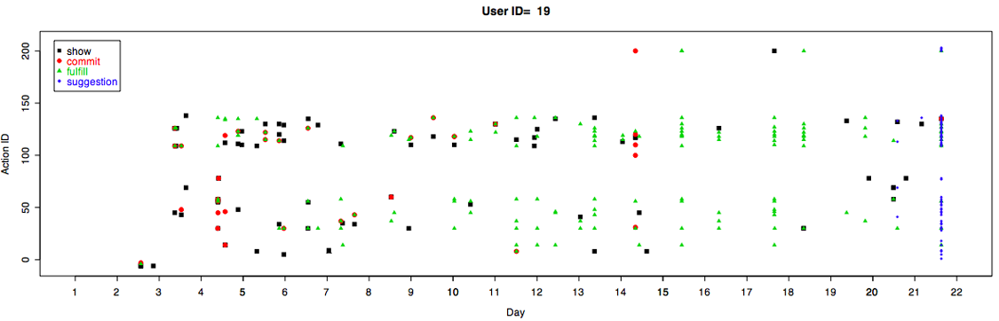
Digging Deeper…
Patterns of learning, commitment, fulfillment, getting suggestions
Notes:
One pair of participants frequently and reciprocally visited each others’ pages (7 and 15 times). One other participant frequently visited a friend’s page that did not reciprocate .
1 user reported talking about the site with friends in the same study to remind each other to log in every day (P26 I think). She would have liked to have her friends represented on her visualization.
In our interviews , ten participants told us that they showed the site to others. Communication about the site happened through diverse channels. In some cases, it happened through shared physical spaces. One participant and her 14 year old daughter had a joint MySpace account. The daughter started helping to remind that participant to follow through on her commitments. Two other participants reported showing the site to their partners or housemates.
Two participants reported that multiple friends contacted them by IM with questions and one participant reported getting questions directly on her MySpace. Six friends of participants went as far as clicking on the “Sign Up” link and one requested an account after clicking through to the StepGreen main site.
We did not interview everyone. Probably only 15-20 people. E.g. I only see explicit mention of sharing from about 15 to 20 people total, not 32
Do individual/ethnic differences influence these trajectories?

Slide 99
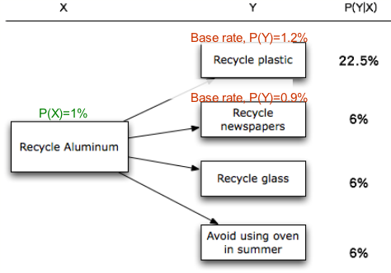
Predicting Next Committed Action- Recycling
Notes:
There are many uses for our data planned in the future. This slide is just one example – developing predictive models that can help us make meaningful recommendations to users.
Based on data from this study, we may predict what’s the next action that a user would commit to based on the current commitment.
So for a user who committed to Recycle Aluminum, about 20% of time she will commit to recycling plastic next.
Note that the base rate for committing “recycle plastic” was only about 1%. So knowing whether the user committed to recycle aluminum is useful in making predictions.
This can be a basis for recommending suitable actions to users

Slide 100
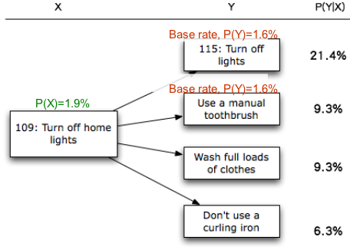
Predicting Next Committed Action- Turning off lights
Notes:
Here is another example.
Similarly, if one committed to turn off home lights, it’s likely that she’ll commit to turn off lights in general and use a manual toothbrush.
The recommendation could be done in two ways. First, we may recommend the actions that one’s likely to commit to, so we lower users’ overhead in searching for actions and promote the system’s usability. Second, we may identify what energy-saving actions are less likely to be considered by the user, and we may try to advertise and promote those actions through various ways. Overall, we might perform more adaptive, strategic persuasion based on the information.

Slide 101

If you want to know more…
Witten, I. H., Frank, E., Hall, M. (2011). Data Mining: Practical Machine Learning Tools and Techniques, third edition, Elsevier: San Francisco

